Slide 1
Parallel TCP
Weice Sun, Zhongyi Luo, Siyuan Peng, Mengying Du, Qiang Wang

Slide 2
What is Parallel TCP?
Data set is divided into a number of smaller chunks, and each component chunk is transmitted using its own TCP session.

Slide 3
Project Objective
Parallel TCP Real Implementation
NS 3 Simulation
Data Analysis

Slide 4
Parallel TCP Real Implementation
Design Principles
Coding Methods
Testing
Data Analysis

Slide 5
Program Flowchart
-- Sender
Divide the file into n chunks
Start
Read file into corresponding buffer
Get destination IP and file path
Send handshake packet to the receiver
No
Check IP
Get Respond
Print Error
Yes
No
Check file path
Yes
Establish parallel connections to send file chunks

Slide 6
-- Receiver
Start
Reorder data from sockets
Ports start listening
No
Read into a buffer
Establish connection
Write data to a new file
Yes
Send ACK to sender
end

Slide 7

Test Results
Exactly the same!
Data Transferred via Parallel TCP

Slide 8
Data Analysis
Is there a trend?
What this implies?
What we do next?

Slide 9
Parallel TCP fairness ---ns3 simulation
Topology:
Simulation Environment:
OSX 10.10.5 2.9 GHz Intel Core i5
ns-3.24.1
Global parameter setting:
Random seed: RngSeedManager::SetSeed(11223344)
Protocol TCP Reno
Segment Size = 512
BW and delay: 5Mbps 10ms & 1Mbps 20ms
Sender
Sink

Slide 10
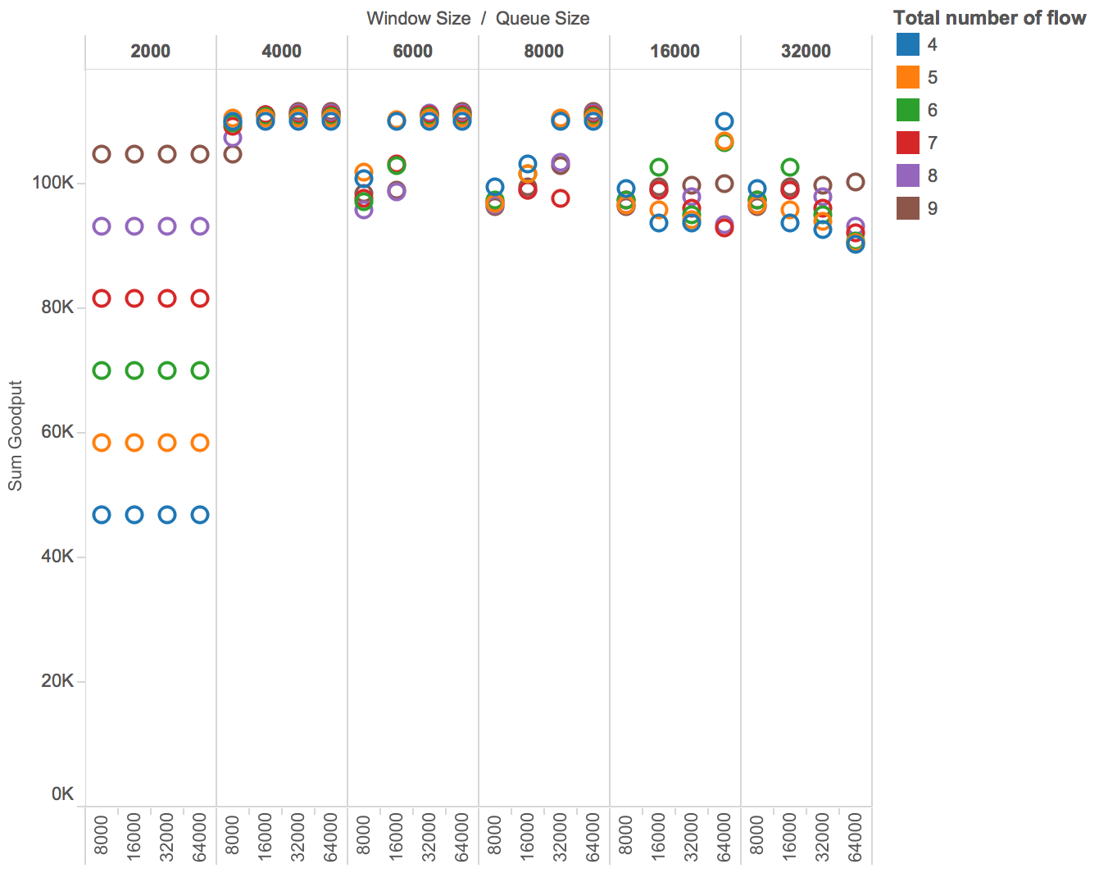
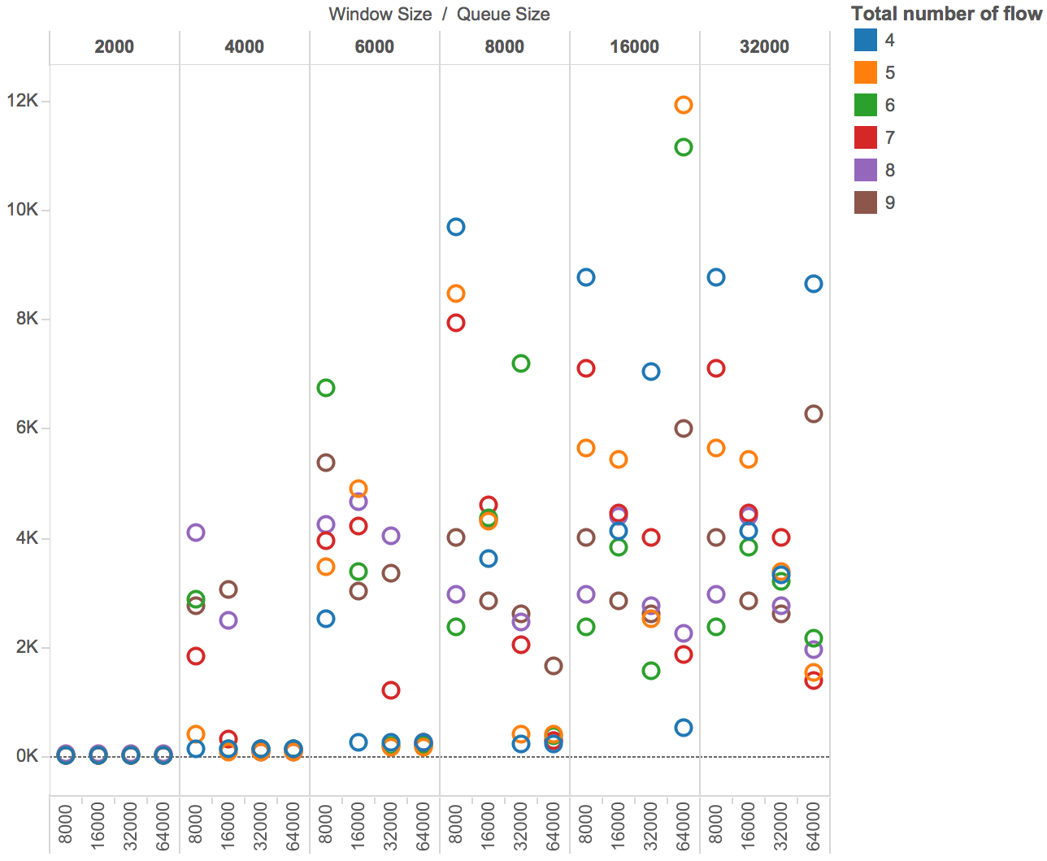
Parallel TCP throughput & standard deviation -- simulation result
Queuing Mode
DropTail Queue
+- 15%
{2000 Bytes
- 32000 Bytes}
Port # 4-6
Window Size
{8000 Bytes
- 64000 Bytes}
Queue Size
Port Number
{4 - 9}
Better fairness

Slide 11
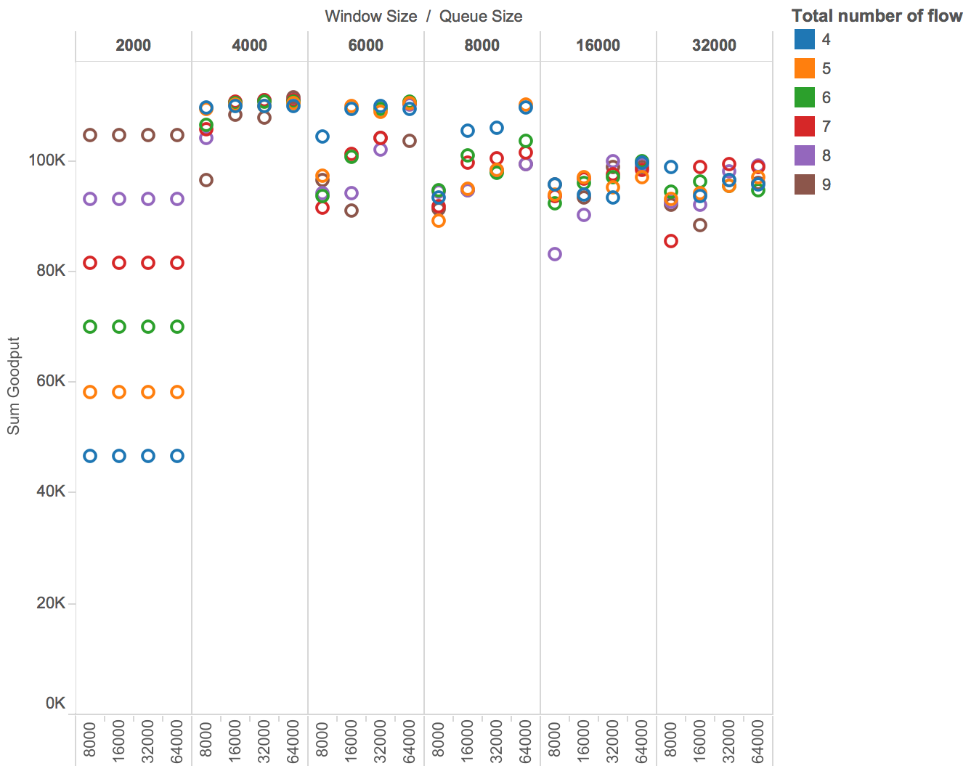
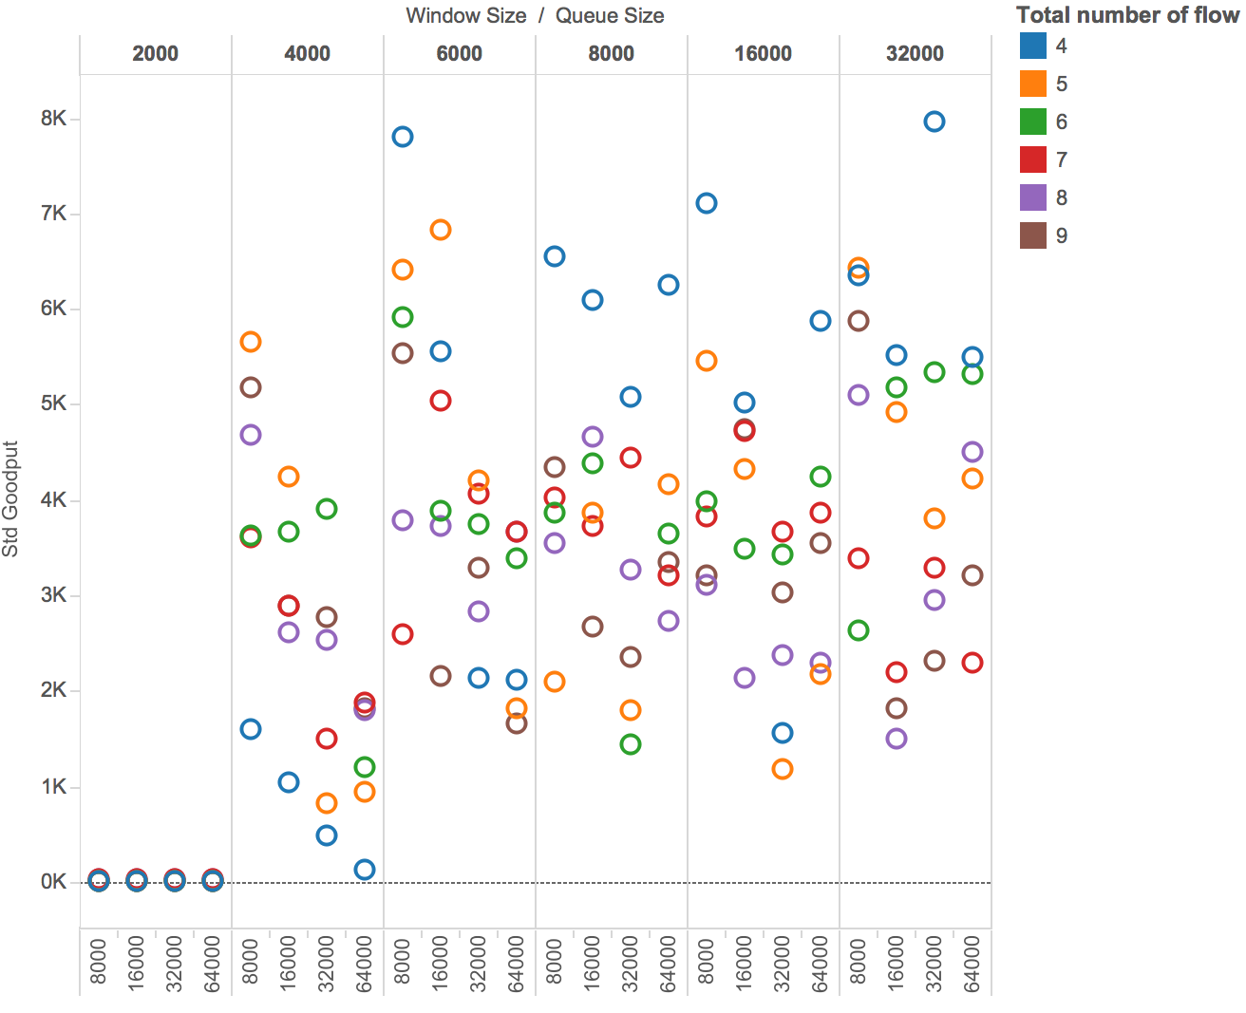
Parallel TCP throughput & standard deviation -- simulation result
Queuing Mode
RED
Queue
+- 10%
Port # 4-5
{2000 Bytes
- 32000 Bytes}
Window Size
{8000 Bytes
- 64000 Bytes}
Queue Size
Port Number
{4 - 9}
Max Thresh: 0.24 * QueueSize;
Min Thresh: 0.04 * QueueSize;
Better fairness

Slide 12
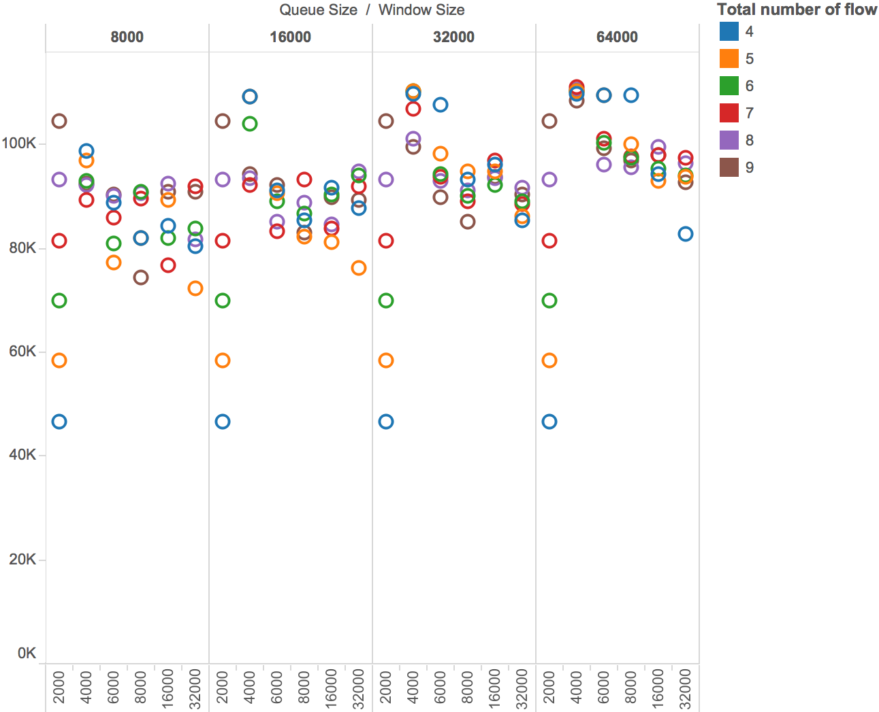
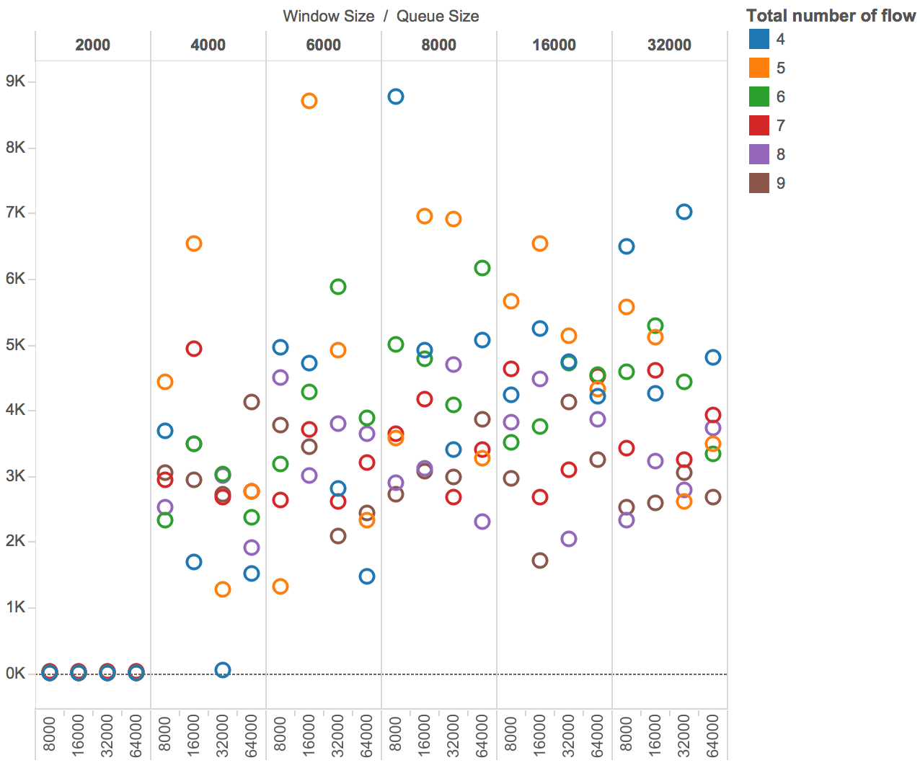
Parallel TCP throughput & standard deviation -- simulation result
Queuing Mode
RED
Queue
{2000 Bytes
- 32000 Bytes}
Port # 4-6
Window Size
+- 18%
{8000 Bytes
- 64000 Bytes}
Queue Size
Port Number
{4 - 9}
Max Thresh: 0.1 * QueueSize;
Min Thresh: 0.04 * QueueSize;
Better fairness

Slide 13
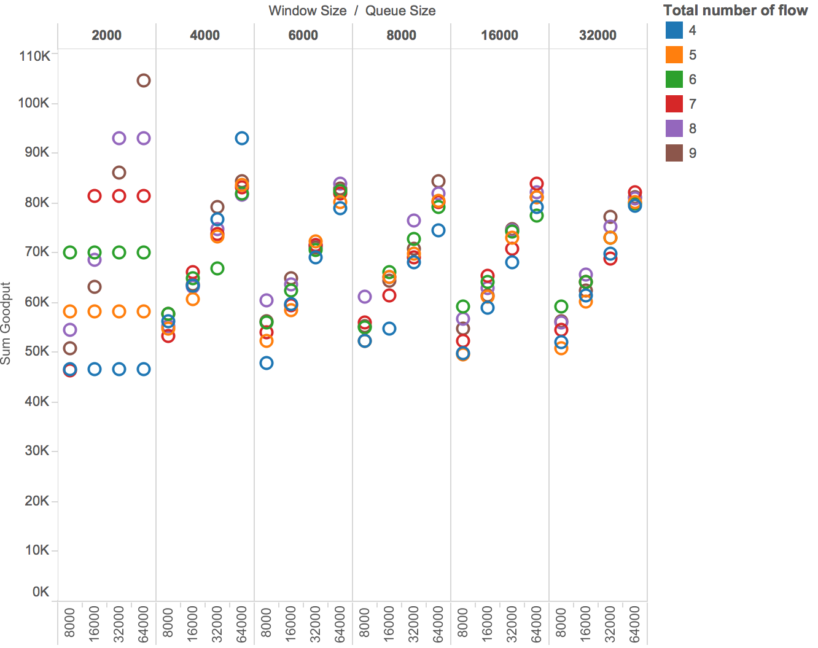
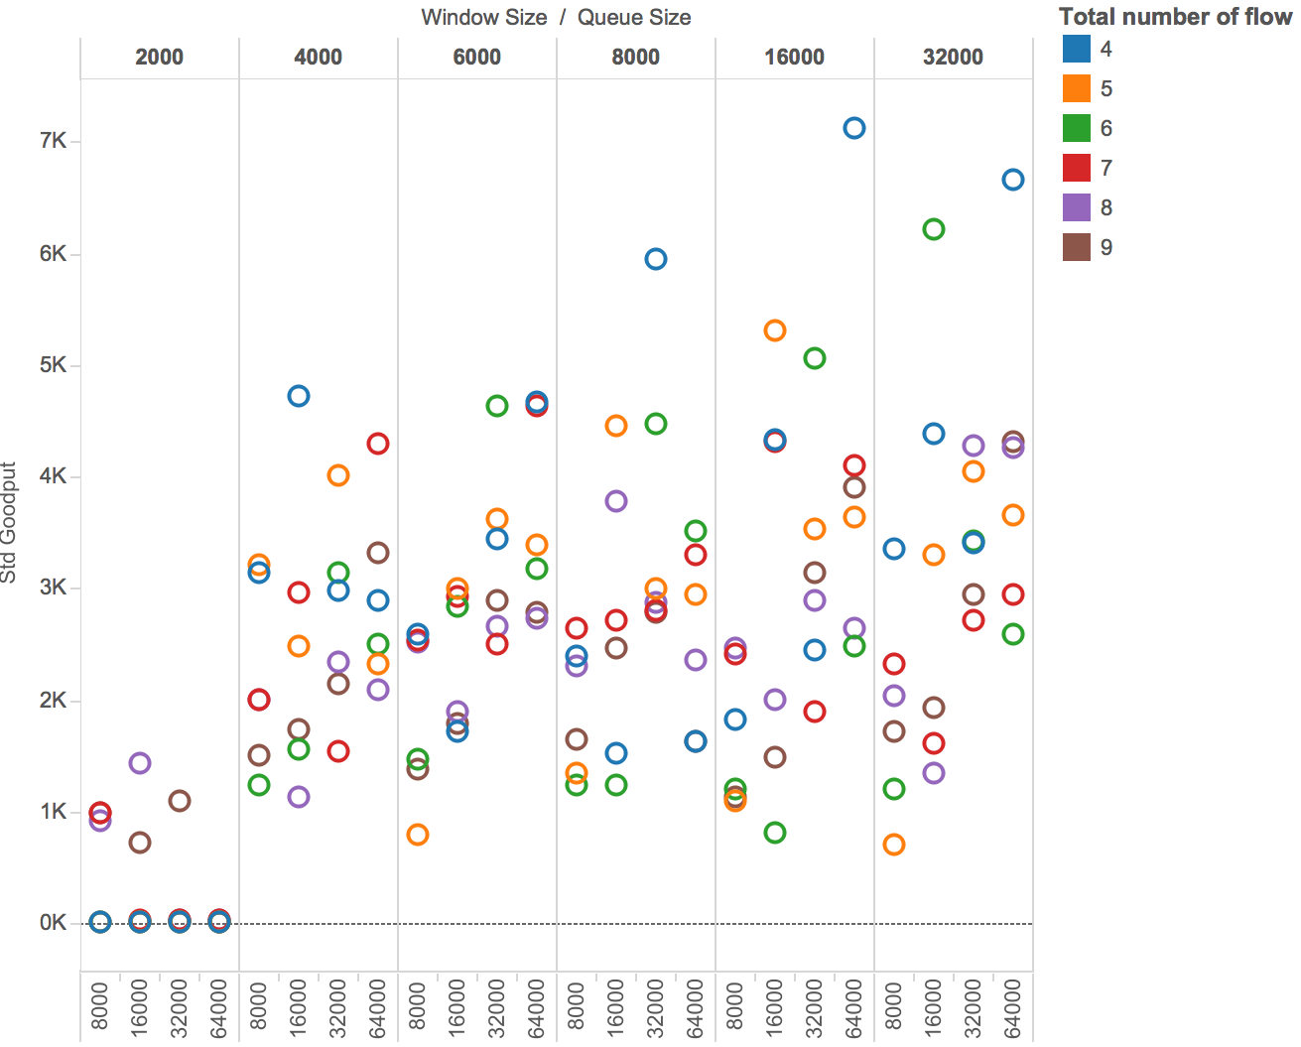
Parallel TCP throughput & standard deviation -- simulation result
Queuing Mode
RED
Queue
{2000 Bytes
- 32000 Bytes}
Port # 4-6
Window Size
{8000 Bytes
- 64000 Bytes}
Queue Size
+- 22%
Port Number
{4 - 9}
Max Thresh: 0.004 * QueueSize;
Min Thresh: 0.0001 * QueueSize;
Better fairness

Slide 14
Conclusion:
Implementation
Validity
Robustness
Efficiency
Simulation
Throughput
Fairness

Slide 15
Q&A

